Slide 1
An Interactive Chatbot For A Restaurant Website

Slide 2
CONTENTS
Introduction
Problem Statement
Objectives
Motivation
Literature Survey
System Architecture
Algorithms
Algorithm overview
Outcomes & Screenshots
Future Scope
Conclusion
References

Slide 3
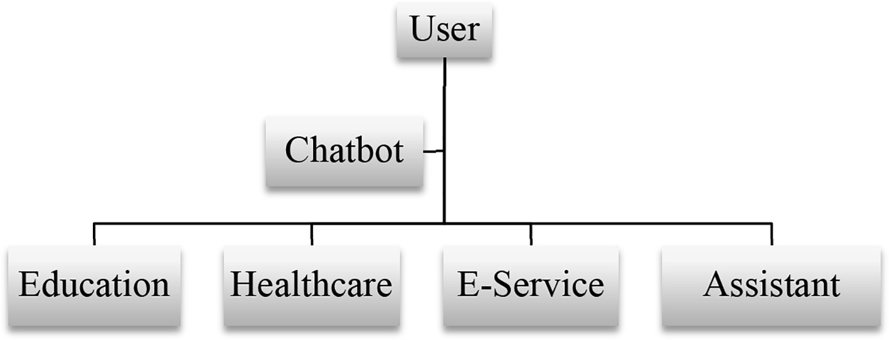
INTRODUCTION
The Chatbot can be defined as a software which help humans to make coherent conversation with machine using natural language like English, etc.
The conversation can be engaging at times with large vocabularies and broad range of conversational topics.
Recently, the usage of deep learning has increased in industry and Chatbot is one of its application .
The Chatbot has various applications as shown in below fig.

Slide 4
PROBLEM STATEMENT
To create a Chatbot, which can seamlessly integrate with our restaurant website, understand user queries, and provide accurate responses .
The chatbot provides features like Placing order, Tracking order, interaction with voice and bilingual support to enhance the overall experience of customers.

Slide 5
OBJECTIVES
1) To enable the chatbot to communicate effectively with users in two languages English and Hindi.
2) To allow users to interact with the chatbot using their voice instead of typing, which is more convenient for user.
3)Reduce operational workload on staff, allowing them to focus on food preparation and service.
4)To enable chatbot to assist user in placing and tracking their orders easily.
5)Enhance order accuracy and processing speed through automated systems.

Slide 6
MOTIVATION
Enhance customer satisfaction by providing a seamless and efficient ordering experience.
Address the growing need for automation in the restaurant industry to handle high volumes of customer interactions
Expand the restaurant's customer base by offering bilingual support and accessible services.
Increase operational efficiency, allowing staff to focus on core tasks and improving overall service quality.
Saves time and money by automating tasks.

Slide 7
LITERATURE SURVEY
Sr. No. | Title of Paper | Year of Publication | Algorithm / Method used | Features / Advantages | Conclusion
1) | Developing English Conversation Chatbot Using Dialogflow | 2020 | Google Dialogflow Natural Language Processing | This paper focuses on developing English conversation chatbot using speech recognition and artificial intelligence technology with Dialogflow platform as the artificial intelligence engine. | A chatbot using Dialogflow is created which make the conversions with humans easily.
2) | Summarizing Indian Languages using Multilingual Transformers based Models | 2023 | In this they have experimented two models:- IndicBART mT5 | The main feature is to generate summary for the articles and headline pairs 3 languages viz. English, Hindi, Gujarati. | Performed various experiments with multilingual transformer based models like IndicBART and mT5-small and achieved significant results.

Slide 8
Sr. No. | Title of Paper | Year of Publication | Algorithm / Method used | Features / Advantages | Conclusion
3) | A Comprehensive Review of Transformer models and their Implementation in Machine Translation | 2023 | Natural Language processing Transformers models BERT XLM | In this they have implemented a multilingual low resource machine translation model which use advance deep learning techniques to build a Punjabi to English and English to Punjabi. | In this paper there is a comprehensive review of different transformers along with their characteristics , further reviewed the MT(machine Translation) work done on various Indian languages along with their performance metrics.
4) | Speech to text conversion and summarization for effective understanding and documentation | 2019 | Filtering Algorithms Studied:- Natural language processing Speech recognition Text summarization | Provide best recommendations for users using the available data. | Successfully overviewed the different filtering algorithms and predicting algorithms and when to use them on availability of data.

Slide 9
SYSTEM ARCHITECTURE
Architectural Components :
User Interface (UI) Layer : This layer includes the frontend technologies such as HTML, CSS, JavaScript, and frameworks
Chatbot Layer: This layer includes google Dialogflow and voice to text conversion fundamentals.
Backend Services: Custom backend services that interact with Google Dialogflow to process complex business logic, handle user requests, and fetch data from the database or other external services.
Database Layer: Stores user data, order details, menu items, and other relevant information. Common choices include MySQL.

Slide 10
Component | Description
User Interfaces | Interfaces through which users interact with the chatbot.
- Web | Web interface for desktop and mobile browsers.
- Voice | Voice interaction interface.
Chatbot Layer | Core components for natural language processing and voice recognition.
- Dialogflow | Handles natural language understanding and processing.
-Speech-to-Text API | Converts voice commands to text.
Backend Services | Custom backend services for processing user requests and managing business logic.
- Webhooks | Interfaces that connect Dialogflow to custom backend logic.
-Order Management | Manages the lifecycle of user orders.
Database Layer | Stores user data, orders, and menu items.

Slide 11
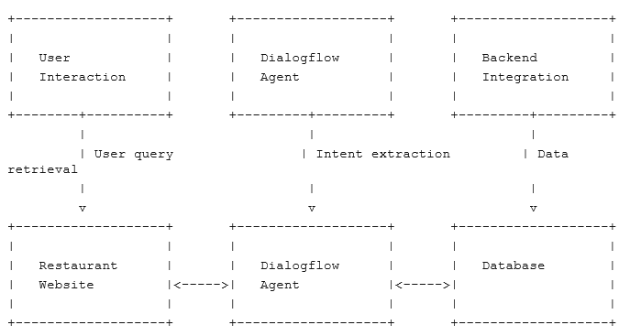
Fig. System Architecture

Slide 12
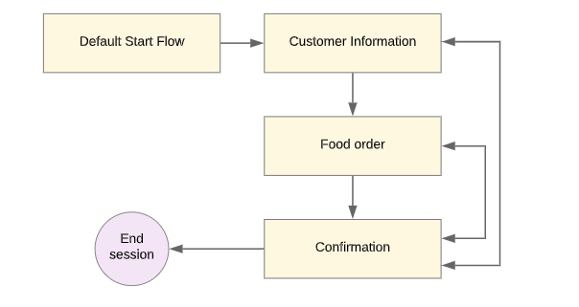

Slide 13
ALGORITHMS
Intent Recognition
Entity Recognition
Context Management
Machine Learning

Slide 14
ALGORITHM OVERVIEW
Intent Recognition:
Intent recognition algorithms are crucial for identifying the user's intention or purpose behind their message.
These algorithms analyze the context and content of user input to determine the most relevant intent.
Dialogflow's intent recognition capabilities allow the chatbot to understand various user queries and provide appropriate responses tailored to the user's needs.
Entity Recognition:
Entity recognition algorithms help identify specific pieces of information within user input that are relevant to the conversation.
Entities can include dates, locations, product names, or any other information necessary for understanding the user's request.
Dialogflow's entity recognition capabilities enable the chatbot to extract and utilize this information to personalize responses or perform specific actions.

Slide 15
Context Management:
Dialogflow employs algorithms for managing conversational context, allowing the chatbot to maintain a coherent dialogue with users.
Context management enables the chatbot to remember previous interactions and use that information to provide more meaningful responses.
By keeping track of the conversation history, Dialogflow ensures a seamless and engaging user experience.
Machine Learning:
Machine learning plays a vital role in enhancing Dialogflow's understanding of natural language.
By leveraging machine learning algorithms, Dialogflow continuously learns from user interactions to improve its ability to recognize intents and entities accurately.
Over time, this iterative learning process enhances the accuracy and efficiency of the chatbot's responses.

Slide 16
OUTCOMES & SCREENSHOTS
Enhanced User Experience
Result: The chatbot provided an intuitive and user-friendly interface for customers to interact with the restaurant's online ordering system. Outcome: Increased customer satisfaction and engagement due to a streamlined and efficient ordering process.
Increased Efficiency
Result: Automation of the order-taking process reduced the workload on restaurant staff, enabling them to focus more on food preparation and service. Outcome: Improved operational efficiency and faster order fulfillment times.
Bilingual Support
Result: The chatbot supported multiple languages, enabling non-English speaking users to interact with the system. Outcome: Broader customer base and improved accessibility for diverse audiences.
Real-Time Interaction
Result: The chatbot provided real-time responses to customer queries and feedback. Outcome: Enhanced customer engagement and immediate issue resolution.

Slide 17
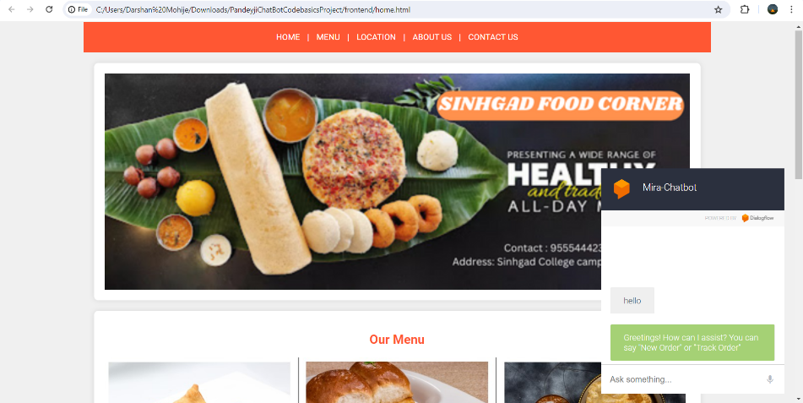

Slide 18
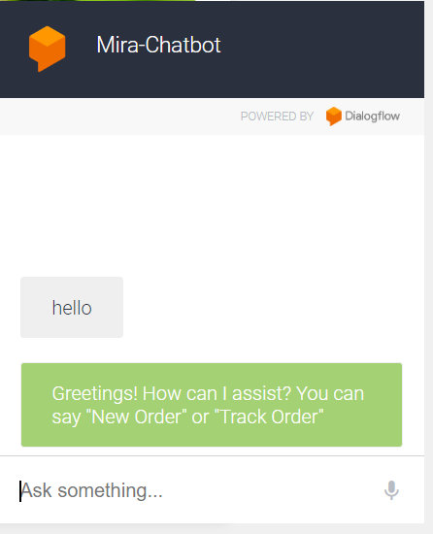
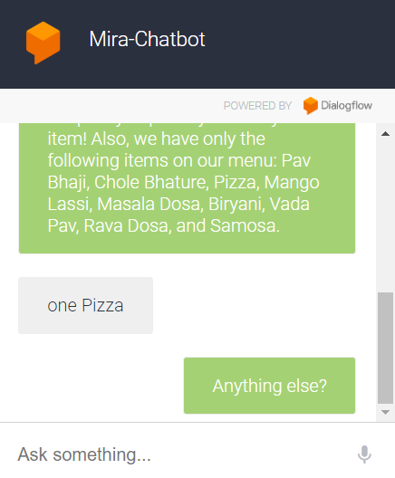

Slide 19
FUTURE SCOPE
Enhanced Personalization: Implement advanced machine learning techniques to personalize user interactions, such as recommending tailored menu items based on past orders and preferences.
Multi-language Support: Extend language support beyond the current language to cater to a broader user base, facilitating seamless communication for users with diverse linguistic backgrounds.
Voice Recognition Improvements: Continuously refine the voice recognition capabilities to improve accuracy and responsiveness, enhancing the usability of the voice-to-text feature.
Integration with IoT Devices: Explore integration with Internet of Things (IoT) devices, such as smart speakers or wearable devices, to enable voice-based ordering and interactions in smart home environments.

Slide 20
CONCLUSION
In conclusion, the development of the food delivery chatbot application has been a significant endeavor, resulting in a robust and feature-rich solution for enhancing the restaurant's online ordering experience.
Through meticulous planning, design, implementation, and testing, the chatbot application demonstrates its ability to streamline the ordering process, improve customer engagement, and optimize operational efficiency for the restaurant.

Slide 21
REFERENCES
[1] Sumaia Mohammed AL-Ghuribi and Shahrul Azman Mohd Noah (2021)
A Comprehensive Overview of Recommender System and Sentiment
Analysis.
[2] Dhaval Taunk, Vasudeva Varma (2023)
Summarizing Indian Languages using Multilingual Transformers based
Models.
International Institute of Information Technology, Hyderabad, Telangana, India. Forum for Information Retrieval Evaluation 2022
[3] Moh Hasbi Assidiqi, Salim Nabhan (2020)
Developing English conversation chatbot using Dialogflow
[4]Rituraj Dixit, Sarabjeet Singh Bedi, Madhuri Tayal (2023)
A Comprehensive Review of Transformer models and their Implementation in Machine Translation specifically on Indian Regional Languages
MJP Rohilkhand University, Bareily , UP , India

Slide 22
THANK YOU!

